Slide 1
Operating Systems
CEIS106
FINAL PROJECT
Johnathan Shoff

Slide 2
Navigate the Linux filesystem tree
1. What is the pwd command an acronym for? What about the cd command?
Answer here: pwd stands for present working directory
cd stands for change directory
2. Explain the differences between a relative path and an absolute/full path in Linux.
Answer here:
A relative path is based on the current directory to the file, while an absolute path is from the root directory to the file.

Slide 3
Create directories and files

Slide 4
Copy and remove directories and files

Slide 5
Locate directories and files

Slide 6
Create a shell script
1. What are the file permissions of the script?
Answer here: 664
2. What’s the name of the user-defined variable in the script?
Answer here: text
3. Which redirection meta-character is used in the script? What does it do?
Answer here: >> it allows us to append data to an existing file, without overwriting the existing contents.

Slide 7
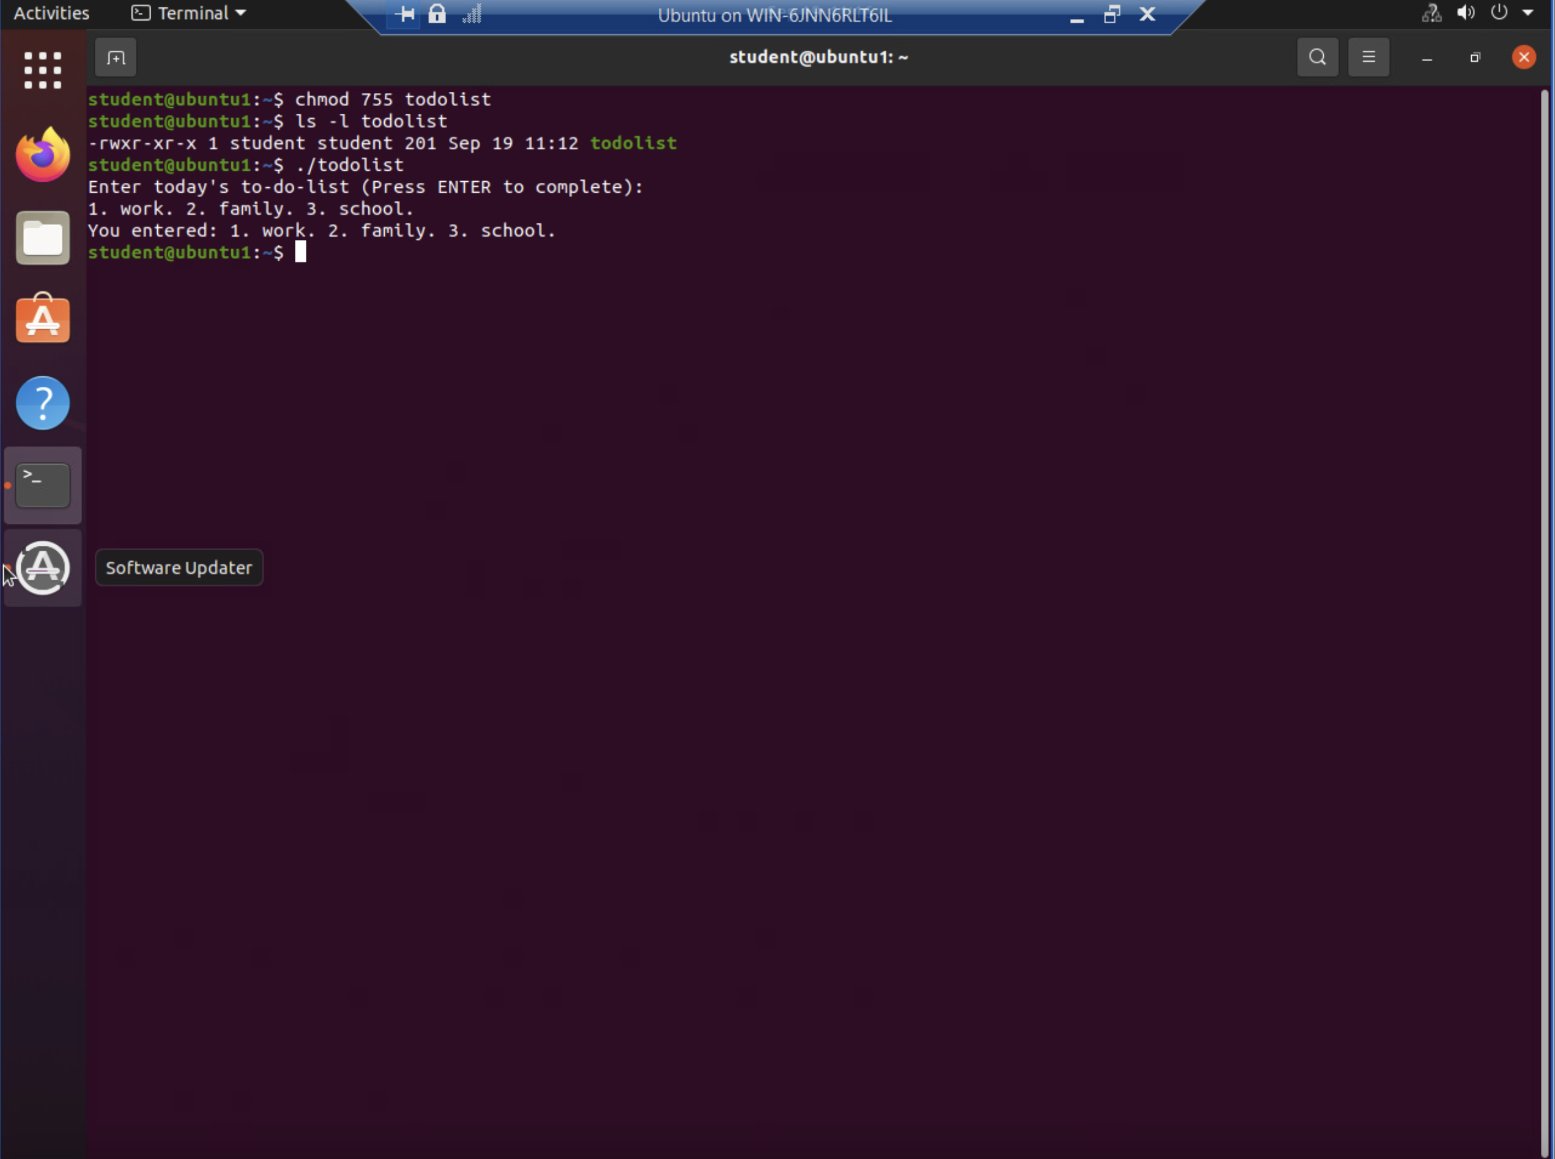
Change script file permissions

Slide 8
Set the PATH variable

Slide 9
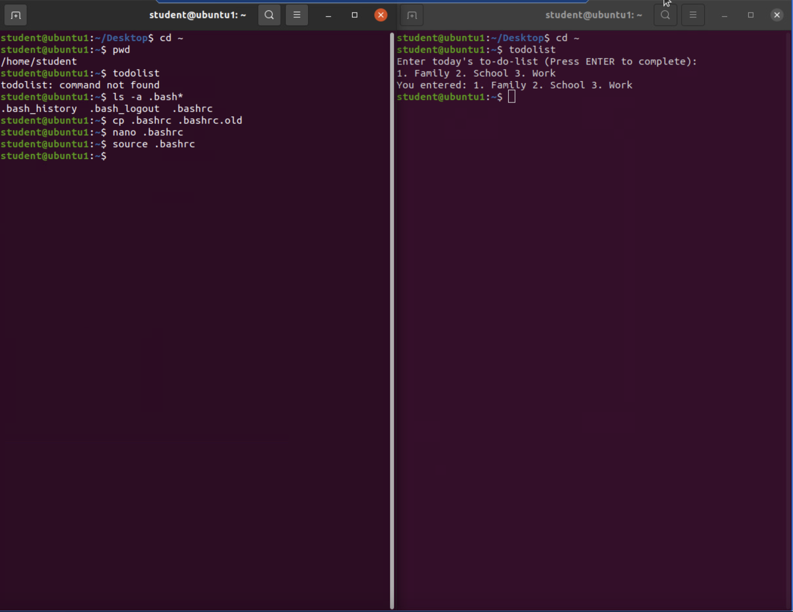
Make the PATH variable permanent

Slide 10
Add users and groups in CLI
1. What does the –m option in the useradd command do?
Answer here: Using the –m flag when running useradd creates the home directory.
2. What does the -3 option in the tail command do?
Answer here: It gets the last three entries in a file.
3. Which line of the /etc/group file lists members of the “students” group? Copy it here.
Answer here: The last line in the file, since we used sudo tail -3 /etc/group to get the last three lines from the file.
students:x:1002:student,mary

Slide 11
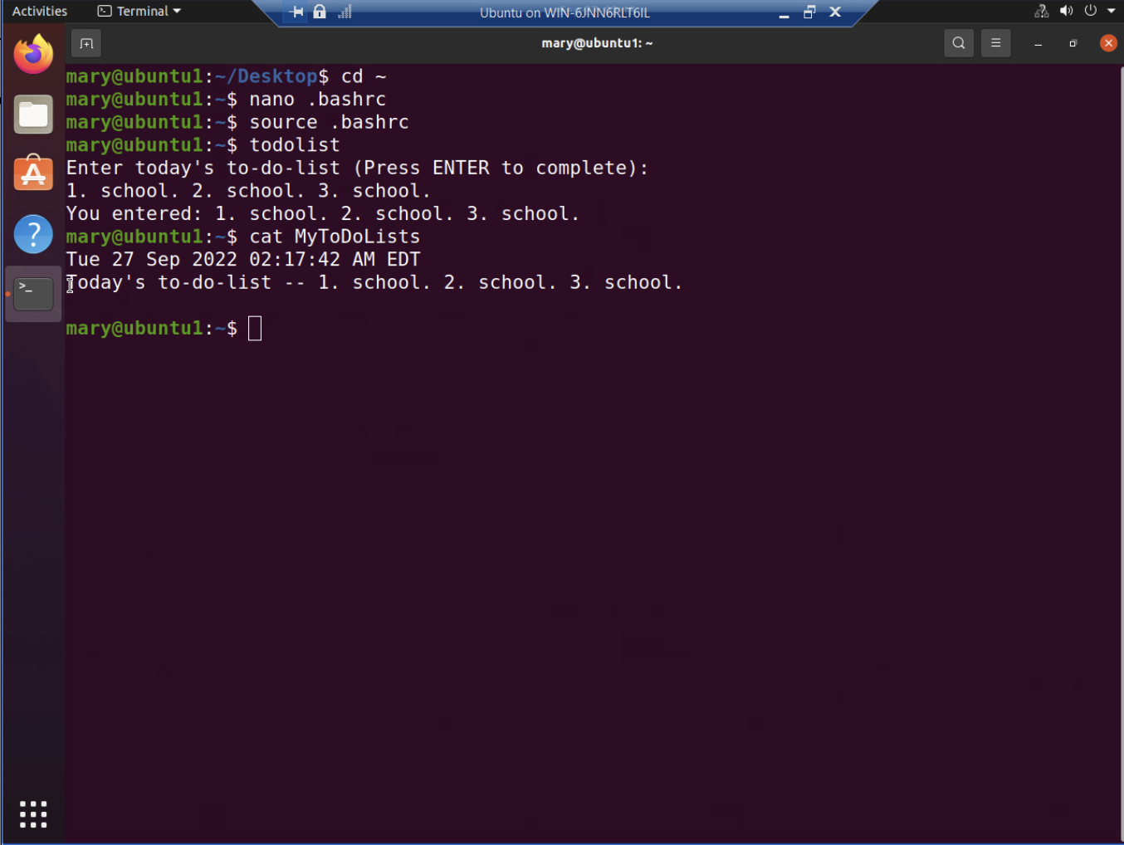
Test user and group settings

Slide 12
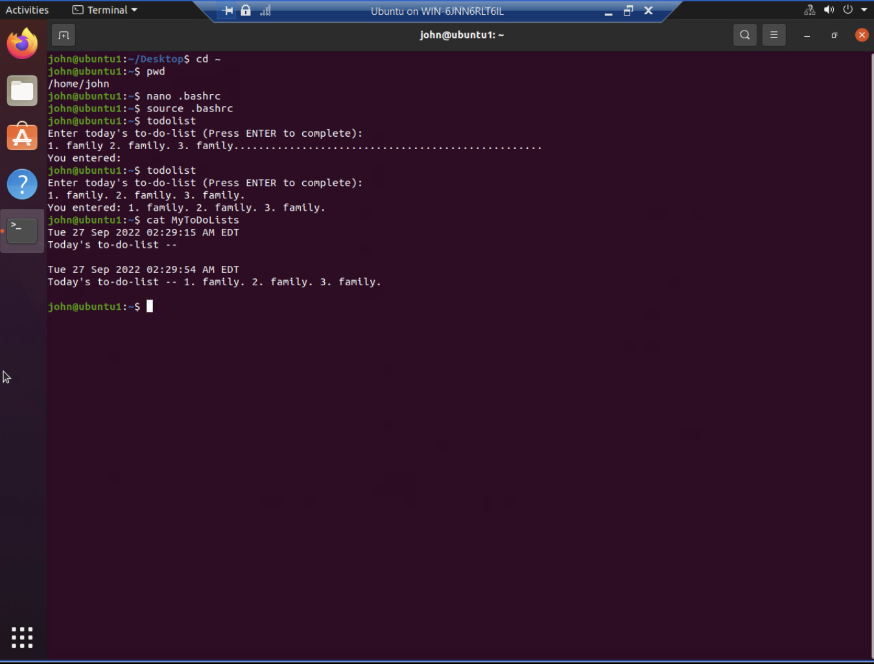
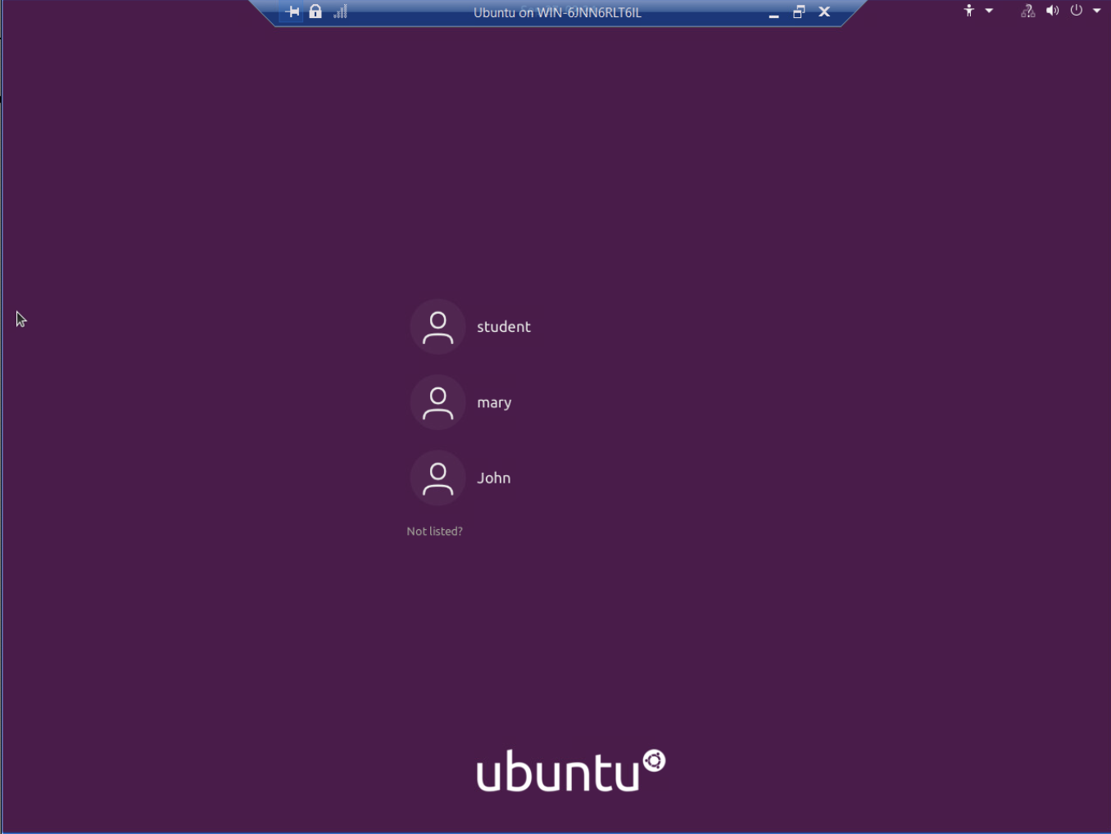
Add users in GUI

Slide 13
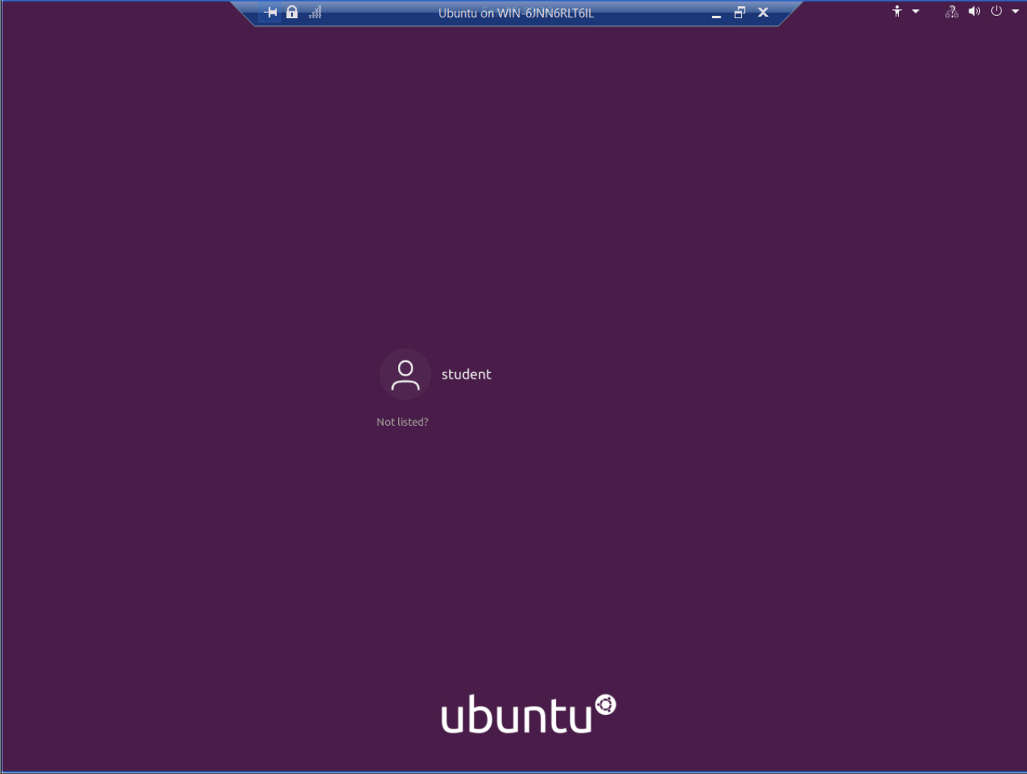
Remove users and groups

Slide 14
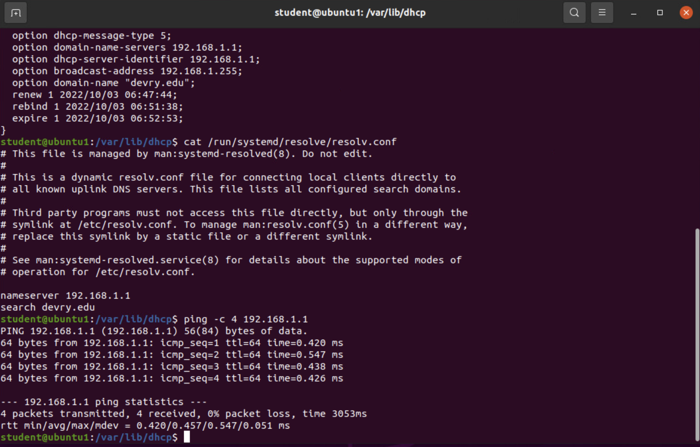
Discover host IP configurations
1. What is the IP address of your Ubuntu machine?
Answer here: 192.168.1.107
2. What is the IP address of its default gateway?
Answer here: 192.168.1.1
3. What is the IP address of its DHCP server?
Answer here: 192.168.1.1
4. What is the IP address of its DNS server?
Answer here: 192.168.1.1

Slide 15
Manage network interfaces
1. Which DHCP message is shown in the output of the sudo dhclient –v –r eth0 command? [hint: the message name is in uppercase.]
Answer here: DHCPRELEASE
2. Which four DHCP messages are shown in the output of the sudo dhclient –v eth0 command? [hint: the message names are in uppercase.]
Answer here:
DHCPDISCOVER
DHCPOFFER
DHCPREQUEST
DHCPPACK

Slide 16
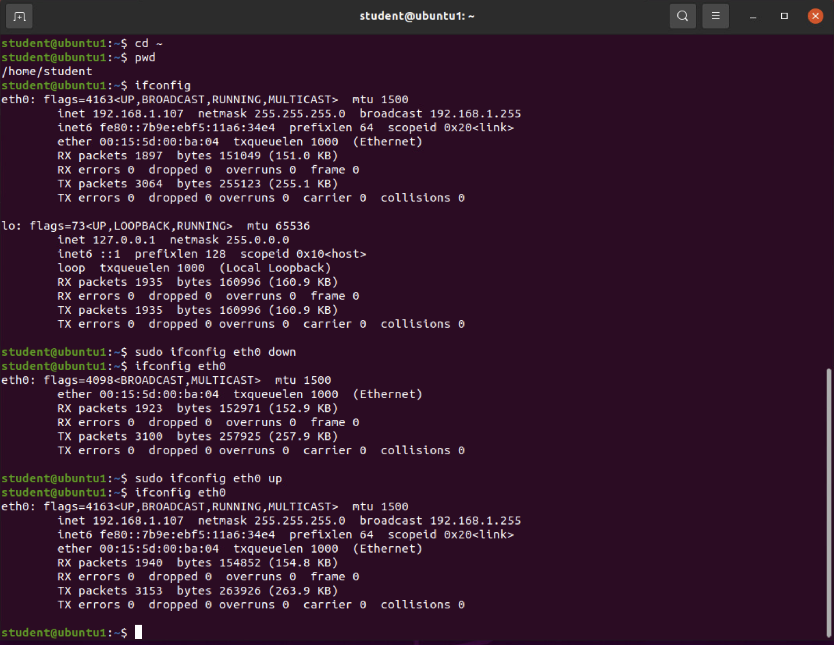
Use network utilities

Slide 17
Monitor Linux processes
1. What is the default action of the 15 SIGTERM kill signal?
Answer here: It stops the current application that is running with that process ID.
2. In the System Monitor window, click on % CPU to sort the processes by CPU load. Which process shows the highest percentage of CPU usage?
Answer here: Gnome Shell

Slide 18
Monitor user activities
Issue the sudo accton on command to turn on GNC accounting. Run the sudo updatedb command. Enter lastcomm updatedb to check if the updatedb command was executed before. Remember to turn off GNC accounting (sudo accton off) after answering the questions.
1. What flag value is displayed in the output?
Answer here: The flag value S is displayed meaning that it was recorded by the system as executed by super-user.
2. Why is the name of the user who ran the processes shown as root, not student?
Answer here: Because the sudo command runs commands as the root user, instead of the currently logged in user.

Slide 19
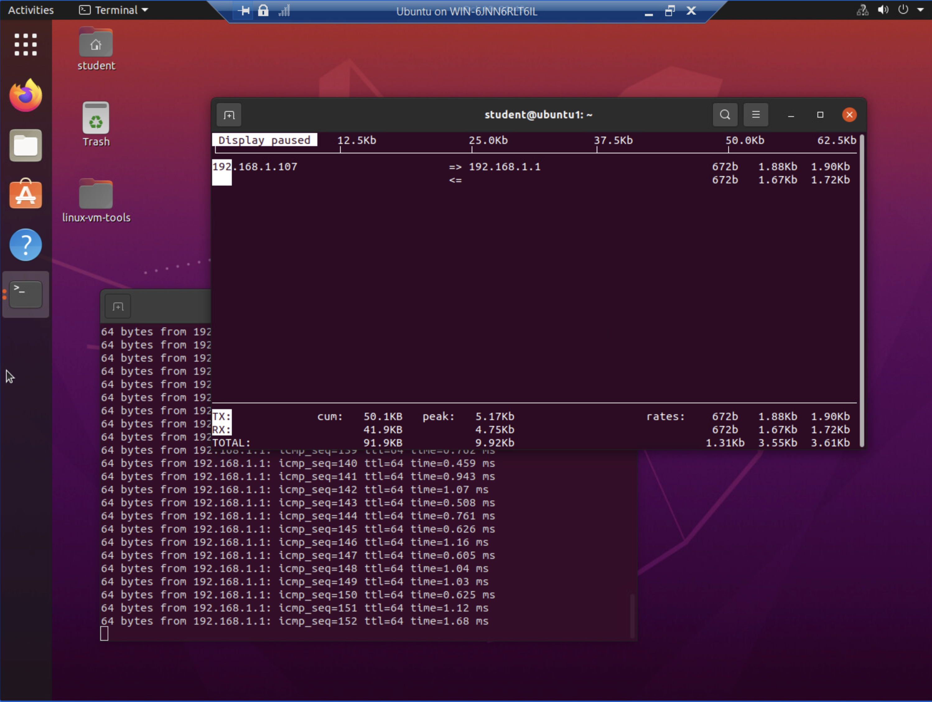
Monitor network bandwidth usage

Slide 20
Challenges DURING THE PROJECT
Linux has a lot of terminology, I found that it was difficult to keep it in my head.
There were some challenges remembering commands during the quizzes.
Networking is a challenging topic to understand especially CIDR notation.

Slide 21
Skills acquired during the course
I learned how to install any Linux distribution for both client and server systems.
I learned how to troubleshoot network problem in the Linux environments.
I learned how to add, remove, and update new users.
I learned how to add, remove, and manage user groups.
I learned how to write shell scripts to automate common tasks.
I learned how work with Linux in a cloud environment.

Slide 22
Course Conclusion
The CEIS 106 course is a challenging, yet very rewarding course. It provides in-depth knowledge of working with an industry standard operating system, that is used in most professional places on the backend. Chances are if you are connecting to a cloud service it is running on a virtualized Linux system. We interact with Linux based systems every day without even realizing it. Linux does not have to be a scary operating system, while most versions are more technical there are many versions that can be just as friendly to new users as any other common operating system. Linux gives power back to the user, and while this is awesome you need to be careful when using a Linux system.

